Slide 1

NUS IT Internship Final Presentation
Sim Sheng Xue
Tishya Khanna
Notes:
Good morning, my name is Sheng Xue, and together with my team mate Tishya,, we would like to present our winter internship project, NoSqueeze

Slide 2


Motivation
Goal
NoSqueeze
Tools
Future
Notes:
In this presentation, we shall be going over the motivation for this app, the end goal, our actual application, the tools we used and our future plans.

Slide 3


3 Bus Journeys
10 Minutes Each
5000 Hours a Day
Motivation
Goal
NoSqueeze
Tools
Future
Notes:
NUS is a large campus, and the buses are an integral part of the lives of both students and staff. Based on our survey, we found that roughly 5000 man hours are spent on the NUS buses daily. With such a large amount of time being spent on buses, it is crucial to provide the best possible service.

Slide 4



86%
76%
82%
Time
Comfort
Safety
Miss 1-2 buses
Find the buses uncomfortable
Find the buses unsafe
Motivation
Goal
NoSqueeze
Tools
Future
Notes:
Based on our survey, we found that 86% of students miss 1-2 buses, 76% find the buses uncomfortable and 82% find the the buses to be unsafe. Clearly, there is room for improvement

Slide 5



Our Goal
Provide information
Disperse Crowds
Improve student life
Motivation
Goal
NoSqueeze
Tools
Future
Notes:
Through our app, we hope to provide information to students so that they can plan their days better, hence dispersing crowds and improving student life as a whole

Slide 6





NoSqueeze
Predict crowd levels using Wifi Data
Work around student’s class timetable + preferences
Produce ideal travel routes
Motivation
Goal
NoSqueeze
Tools
Future
Notes:
Thus, we present to you NoSqueeze, our mobile application which predicts crowd levels using wifi data and takes into account student’s class tmetables and preferences to provide the ideal travel routes for each student

Slide 7
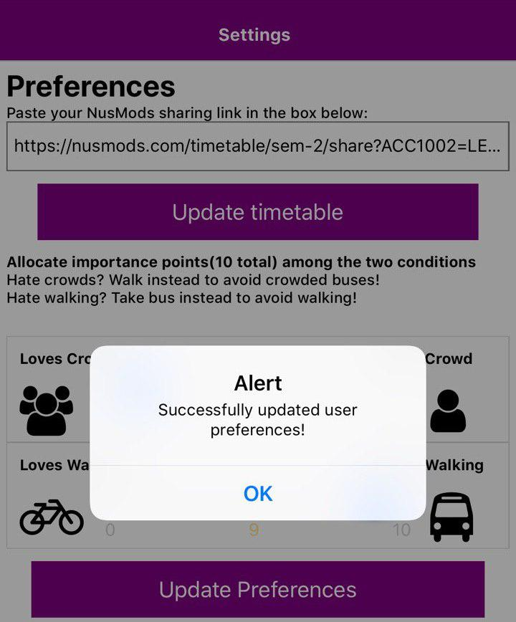
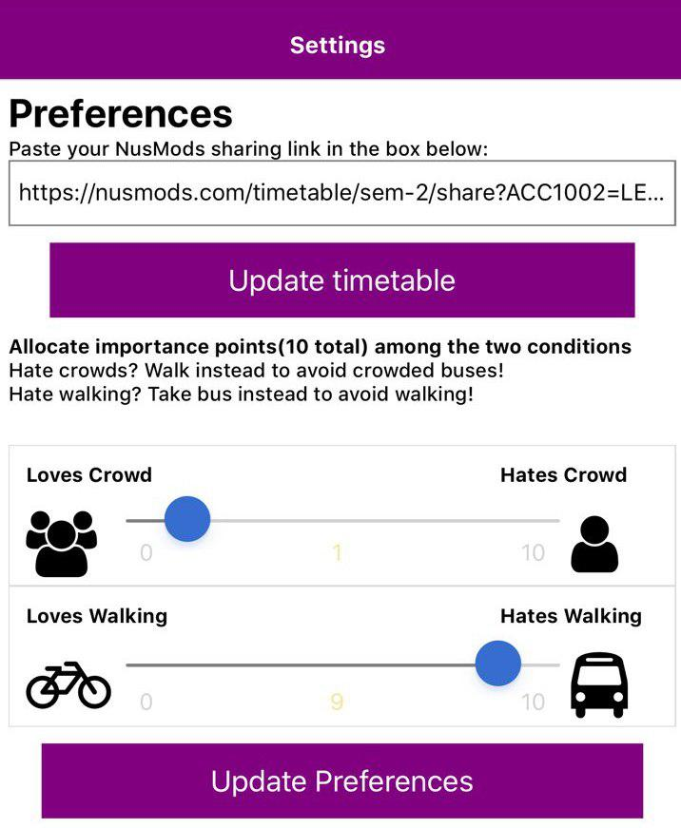
Notes:
Now,I’m going to give you a quick walkthrough of our application. When you first enter, you will be greeted with the settings page. Here, you will set your preferences.
These preferences are universal throughout the application and affect the results that the application gives you. Here, we have 2 preferences, the crowd level preference and walking preference.
Users can choose how much they are willing to “tolerate” crowded buses. So for example, if they were to move the slides to the “loves crowd” part, our application would assume that the user would be willng to get ono the most crowded buses. On the other hand, if the user chooses, “hates crowds” the application will only choose buses which are minimally crowded.
As for the walking preference, we have realized that plenty of users prefer walking to nearby locations in NUS during peak hours. For example, many of my peers choose to walk from the computing building to the central library instead of taking the bus. As a result, we have also included a slides to take into account how far users are willing to walk. Based on some simple surveys, we have found that most users are not willing to walk any further than the distance between computing and IT, which roughly comes up to 500 – 600 metres. As a result, people who love to walk will se their sliders to the extreme left and will get to walk a maximum of 600m. The further and further the slider moves to the right, the smaller the maximum walking distance will be.
Now of course, everyone would want to take empty buses everywhere and as this is near impossible scenario, we have also imposed a restriction on the users, where they can only allocate a maximum of 10 points between the two preferences. Thus, they have to make a decision about what they value more, minimal walking or empty buses.

Slide 8
Notes:
So after choosing the preferences, the user can press the button and these preferneces will then be used by the app in the next part of our application, the path finder

Slide 9
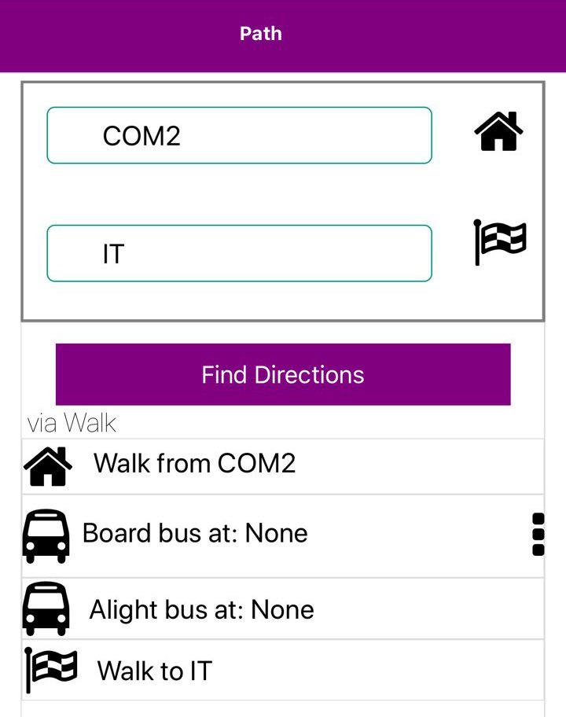
Notes:
This is the path tab, which allows users to find the optimal route for ad hoc journeys made by the user. This path finding algorithm uses the preferences that we mentioned earlier as deciding factors.
Here, we have reset the preferences to someone who likes to walk and wants to travel from Computing to IT. In this case, the buses are more crowded than the user prefers buses to be and as the distance between computing and IT are within the preferred maximum walking distance, our application will tell the user to simply walk.

Slide 10
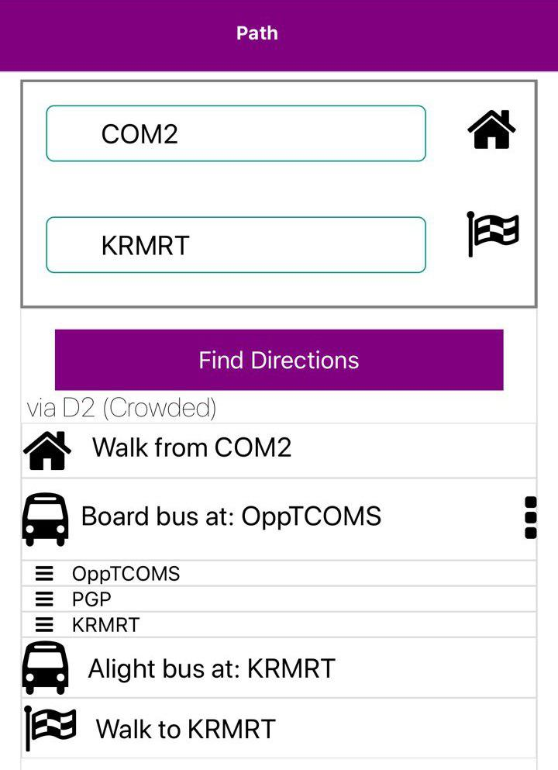
Notes:
Lastly, here, we have the case of the same user travelling from Computing to KR MRT. In this case, the distance between computing and KR MRT is simply too large and as a result, our application tells the user to take the bus D2, despite the high crowd level.

Slide 11
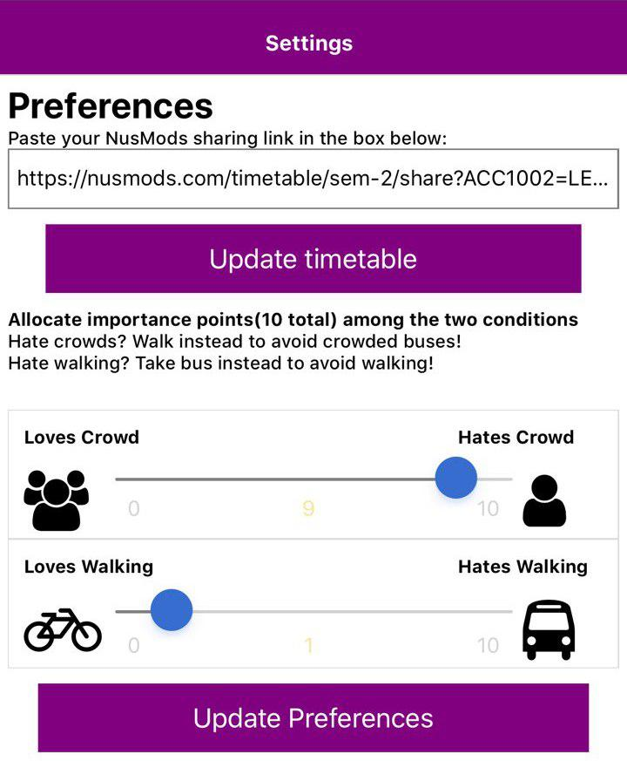
Notes:
Thank you Sheng Xue, hi everyone, my name is Tishya. Now beyond the ad hoc trips, our application goes a step further and allows students to plan out their entire timetable. All the they have to do is to take the link of their timetable from NUS Mods, a module planning website, and paste it into our application

Slide 12
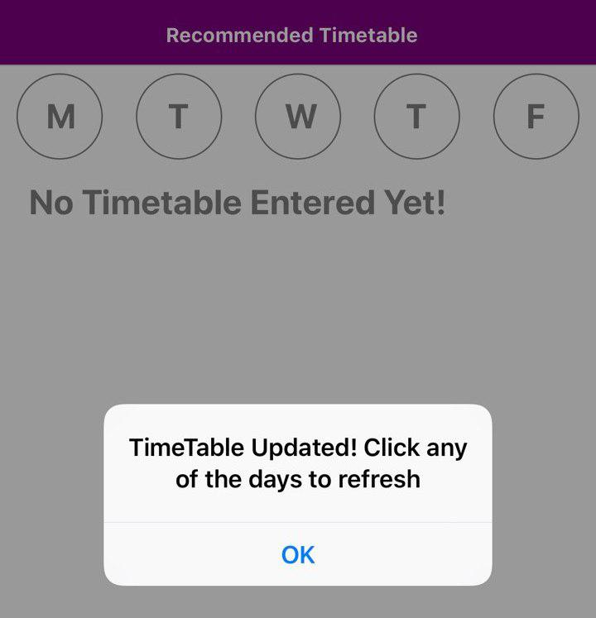
Notes:
Press the button, and

Slide 13
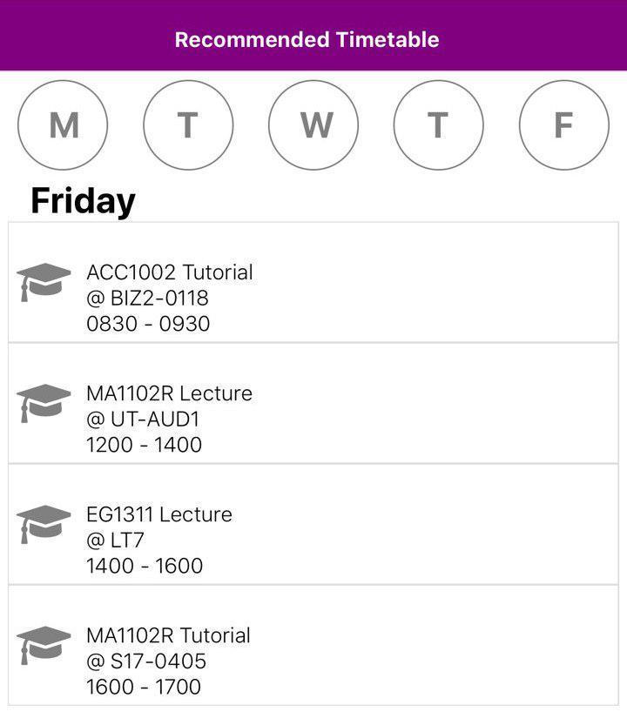
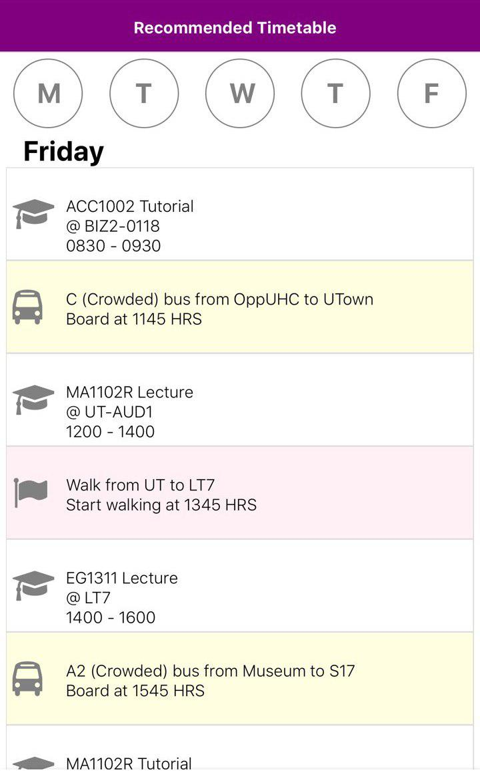
Notes:
Our application will generate the user’s timetable immediately. As you can see, it has been split by days.
At the same time, the application will also generate the optimal routes for the user to take between classes, which can be seen on the right. We even provide reasons,when the buses are crowded, but the distances between the lessons is too far to walk

Slide 14
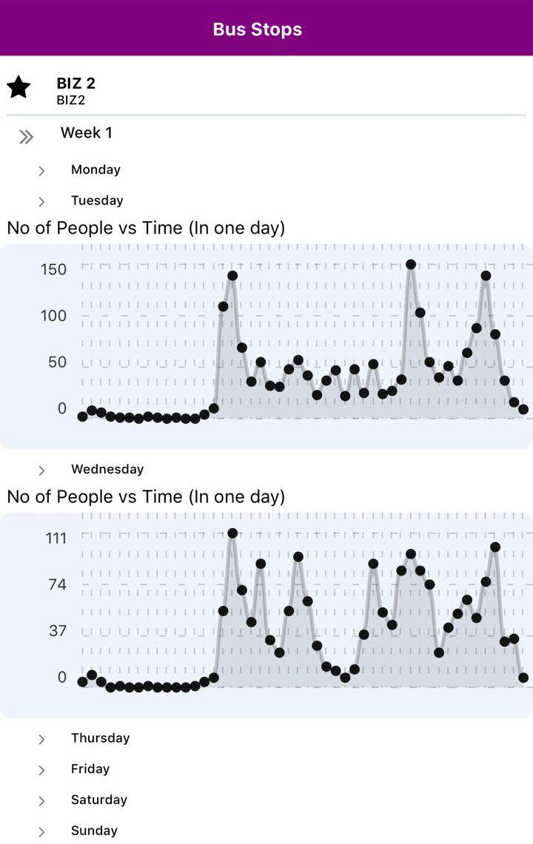
Notes:
Lastly, our application also allows users to see the crowd levels at different bus stops on specific days in the bus stops tab. This crowd data has been created from our analysis of the wifi data across all the NUS bus stops

Slide 15




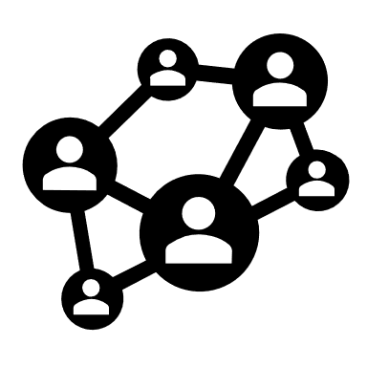
Python Flask
Best Path finding Algorithm
Server and routing
Djikstra’s Shortest Path Algorithm (Modified)
User Interface
Machine Learning
Testing
React Native
Backend
SciKit
Algorithms
Jest
NUS Next Bus UI
OS independent
Ensure the correctness of application through specific test cases
Data cleaning of Wifi data
Polynomial regression to predict crowd levels
Motivation
Goal
NoSqueeze
Tools
Future
Notes:
Now, coming to our process, we used a variety of tools throughout this internship. In the initial stages of our planning, we had the opportunity to meet the creators of the NUS Next Bus application, who were using React Native for their front end. After understanding their tech stack, we too decided to move ahead with React Native for our UI, given that it is OS independent and also allowed for the possibility of future integration and collaboration with NUS Next Bus.
Our local server and routing is done using python flask, again similar to NUS Next bus
For the machine learning aspect, we used the python libraries such as (pandas and numpy) to clean and prepare the wifi data that we received. Then, we used SciKit and polynomial regression to predict the crowd levels throughout the day. This, in fact, is the data that I showed you in the graphs earlier.
For the path finding algorithm, we used Djikstra’s shortest path algorithm and modified it to suit our purposes of the routes in NUS. Mapping bus stops as graph nodes and using travel times as the edge weights, we managed to generate accurate routes.
Lastly, in the later stages of our application, we integrated Jest in order to automate our testing.

Slide 16


Train models
Integrate timetables
Google Maps
Motivation
Goal
NoSqueeze
Tools
Future
Notes:
Given the time constraints of a 5 week internship, there are a few aspects of this application that we would like to work on in the future.
Firstly, after trying multiple data cleaning techniques and machine learning models, we were unable to find the “perfect” model for our application. Thus, we believe that with more data and time, we will be able to provide more accurate crowd prediction techniques.
Secondly, we would also like to increase the accuracy of how we count the number of people at bus stops. Currently, we are only using the number of unique wifi connections at bus stops. After speaking to several directors and the NUS IT team, we were also informed that several techniques such as video analysis, wifi analysis and even manual counting had been tried and had not been very successful. A possible way for us to work around this is to use the timetable of every student to map the number of people moving from venue to venue, based on their next class. We do believe that this will be a useful method as timetables are fixed and will generally provide an accurate representation of the movement of the student body. Thus, we would like to integrate the timetables from NUSMODS to increase the accuracy of our counting.
Lastly, we would also like to include Google Maps in our application to provide a more accurate representation of the distances in NUS.

Slide 17
Motivation
Goal
NoSqueeze
Tools
Future
Notes:
With that, we have come to the end of our presentation, and I would like to thank our supervisers , Adrian and Chee Wei for their guidance, patience and words of encouragement. We would also like to thank Mr Kumar and Mr Linn for their advice. Lastly, we would like to thank NUS IT for giving us the opportunity to develop this app. Thank you.

Slide 19
Python Flask
Best Path finding Algorithm
Server and routing
Djikstra’s Shortest Path Algorithm (Modified)
User Interface
Machine Learning
Testing
React Native
Tensor Flow
Algorithms
Jest
Backend
NUS Next Bus UI
OS independent
Ensure the correctness of application through specific test cases
Data cleaning of Wifi Data
Polynomial regression to predict crowd levels

Slide 20




Current solutions
Walk
Quality and Quantity
Driverless Shuttle
Problem
Goal
NoSqueeze
Value
Future

Slide 21


What’s the REAL problem?
Lack of information
When?
Where?
Which?
Problem
Goal
NoSqueeze
Value
Future

